Slide 1
Self Diagnosable Human Disease Prediction Using Machine Learning
Guide Name:
Mr. G. Balram
(Asst. Professor)
Dept. of CSE
Team Details:
Gajam Nikhil (19H61A05D5)
E. Kruthik Reddy (19H61A05D1)
Gadipe Dolly (19H61A05D4)

Slide 2
ABSTRACT
The rapid proliferation of Computers and handled devices has opened up new avenues for an instant self diagnosable disease prediction. There are instances where computers provide much meaningful and more probable prediction which is easier and faster to grasp than real-world help. People often feel reluctant to go to hospital or physician for minor symptoms. However, in many cases, these minor symptoms may trigger major health hazards. As computers became more powerful, it can be a great head start for users to check the disease according to symptoms. This system analyzes the symptoms provided by the user as input and gives the disease as an output. Prediction is done by using the Naive Bayes Classifier.

Slide 3
INTRODUCTION
Now-a-days, people face various diseases due to the environmental conditions and their living habits. So the prediction of disease at earlier stage becomes important task. The classical diagnosis method is a process where the patient has to visit a doctor, undergo various medical tests, and then come to a conclusion. This process is very time-consuming. To save time required for the initial process of diagnosis symptoms, this project proposes an automated disease prediction system that relies on user input.

Slide 4
LITERATURE SURVEY
In the paper called “Disease Prediction System using data mining techniques” the author has discussed about the data mining techniques like classification, clustering to analyse the different kinds of heart disease based problems. In the paper "A study on data mining prediction techniques in healthcare sector" has mentioned information discovery method and knowledge retrieval method. The paper “Predicting Disease by Using Data Mining Based on Healthcare information System” published in the year 2016 applies the information mining process to predict high blood pressure from patient medical records with eight alternative diseases.

Slide 5
METHODOLOGY USED
Naive Bayes algorithm:
This system accepts the input from the user and predicts the most probable disease. This is achieved with the help of the dataset and the machine learning algorithm. The algorithm here is Naive Bayesian which works on a probabilistic approach. We have imported Scikit to use the library for its implementation. For this, we have used multinomial NB since multiple variants i.e. multiple symptoms are taken.

Slide 6
DATASETS
The dataset was taken from a study conducted at Colombia University. It consists of 150 diseases and each disease consist of an average of 8-10 symptoms. 70% of the dataset used for training was made considering all combinational inputs. The symptoms present for the corresponding disease were marked as 1 and remaining as 0.

Slide 7
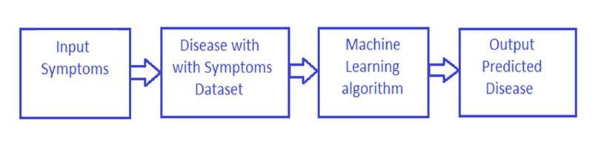
WORKING OF THIS SYSTEM

Slide 8
EXISTING SYSTEM GAPS/LIMITATIONS
We cannot say that every time predicted output has the maximum accuracy.
It takes more time to predict if we are having a huge dataset because model needs to store the entire dataset in the systems RAM.
This system’s prediction can have a biased nature if we give much independent data.
Existing system can predict the disease but not the subtype of disease and it is less accurate.
This model is only valuable in clinical situations.

Slide 9
ADVANTAGES OF PROPOSED SYSTEM
Reduces or eliminates the need of a doctor for common diseases.
Naive Bayes Algorithm is simple and it can handle both continuous and discrete data.
It doesn’t require huge training data. So we can run this system on a small computer without any problem.
It takes less time to train because Naive Bayes is a fast and simple algorithm.
This is more accurate than other existing systems.

Slide 10
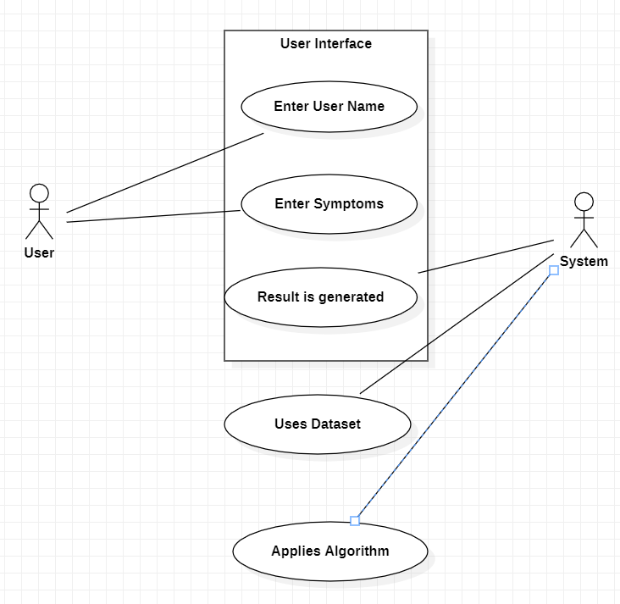
UML DIAGRAMS
Use Case Diagram:

Slide 11
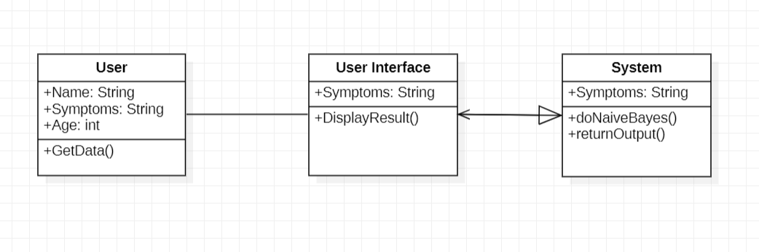
Class Diagram:

Slide 12
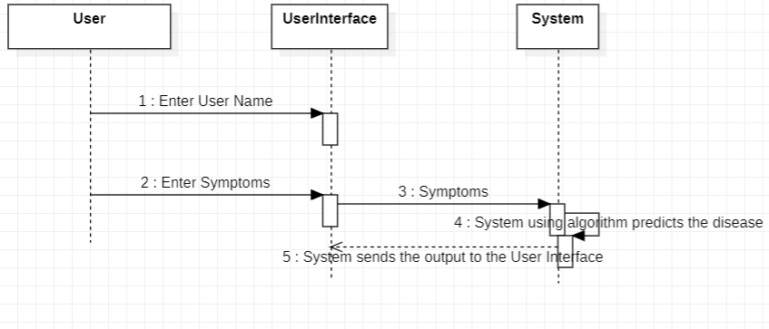
Sequence Diagram:

Slide 13
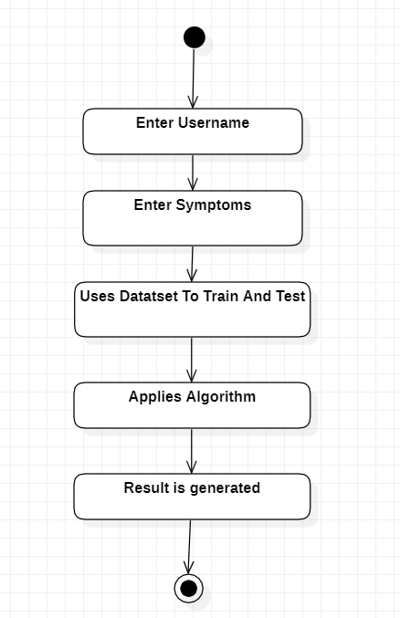
Activity Diagram:

Slide 14
Modules/Packages Used:
Scikit Learn(SKLearn):
Scikit-learn is a free software machine learning library for the Python programming language. It features various classification, regression and clustering algorithms.
NumPy:
NumPy is a library for the Python programming language, adding support for large, multi-dimensional arrays and matrices, along with a large collection of high-level mathematical functions to operate on these arrays.
Pandas:
pandas is a software library written for the Python programming language for data manipulation and analysis. In particular, it offers data structures and operations.
Tkinter:
Tkinter is a Python binding to the Tk GUI toolkit. It is the standard Python interface to the
Tk GUI and used for building the front end of any program in python.

Slide 15
Code:
from tkinter import *
from tkinter import messagebox
from sklearn.naive_bayes import MultinomialNB
from sklearn.metrics import accuracy_score
import numpy as np
import pandas as pd
import warnings l1 = ['itching','skin_rash','nodal_skin_eruptions','continuous_sneezing','shivering','chills','joint_pain',
'stomach_pain','acidity','ulcers_on_tongue','muscle_wasting','vomiting','burning_micturition','spotting_urination','fatigue','weight_gain','anxiety','cold_hands_and_feets','mood_swings','weight_loss','restlessness','lethargy','patches_in_throat','irregular_sugar_level','cough','high_fever','sunken_eyes','breathlessness','sweating','dehydration','indigestion','headache','yellowish_skin','dark_urine','nausea','loss_of_appetite','pain_behind_the_eyes','back_pain','constipation','abdominal_pain','diarrhoea','mild_fever','yellow_urine','yellowing_of_eyes', 'acute_liver_failure','fluid_overload', 'swelling_of_stomach','swelled_lymph_nodes','malaise','blurred_and_distorted_vision','phlegm','throat_irritation','redness_of_eyes','sinus_pressure','runny_nose','congestion','chest_pain','weakness_in_limbs','fast_heart_rate', 'pain_during_bowel_movements','pain_in_anal_region', 'bloody_stool','irritation_in_anus‘,'neck_pain','dizziness','cramps', 'bruising','obesity',

Slide 16
Code:
'swollen_legs','swollen_blood_vessels','puffy_face_and_eyes','enlarged_thyroid','brittle_nails', 'swollen_extremeties','excessive_hunger','extra_marital_contacts','drying_and_tingling_lips','slurred_speech','knee_pain','hip_joint_pain','muscle_weakness','stiff_neck','swelling_joints','movement_stiffness','spinning_movements','loss_of_balance','unsteadiness','weakness_of_one_body_side','loss_of_smell','bladder_discomfort','foul_smell_of_urine','continuous_feel_of_urine','passage_of_gases','internal_itching','toxic_look_(typhos)‘,'depression','irritability','muscle_pain','altered_sensorium','red_spots_over_body','belly_pain','abnormal_menstruation','dischromic _patches', 'watering_from_eyes','increased_appetite','polyuria','family_history','mucoid_sputum','rusty_sputum','lack_of_concentration','visual_disturbances','receiving_blood_transfusion','receiving_unsterile_injections','coma','stomach_bleeding','distention_of_abdomen','history_of_alcohol_consumption', 'fluid_overload','blood_in_sputum','prominent_veins_on_calf','palpitations','painful_walking','pus_filled_pimples','blackheads','scurring','skin_peeling','silver_like_dusting','small_dents_in_nails','inflammatory_nails','blister','red_sore_around_nose','yellow_crust_ooze']
disease = ['Fungal infection','Allergy','GERD','Chronic cholestasis','Drug Reaction', 'Peptic ulcer diseae','AIDS','Diabetes', 'Gastroenteritis','Bronchial Asthma','Hypertension',' Migraine','Cervical spondylosis','Paralysis (brain hemorrhage)','Jaundice','Malaria','Chickenpox','Dengue','Typhoid','hepatitis A',

Slide 17
Code:
'Hepatitis B','Hepatitis C','Hepatitis D','Hepatitis E','Alcoholic hepatitis','Tuberculosis', 'Common Cold','Pneumonia','Dimorphichemmorhoids(piles)','Heartattack','Varicoseveins','Hypothyroidism','Hyperthyroidism','Hypoglycemia','Osteoarthristis','Arthritis','(vertigo) Paroymsal Positional Vertigo','Acne','Urinary tract infection','Psoriasis','Impetigo']
l2 = []
for x in range(0,len(l1)):
l2.append(0)
# Testing Data
testing = pd.read_csv("Testing.csv")
testing.replace({'prognosis':{'Fungal infection':0,'Allergy':1,'GERD':2,'Chronic cholestasis':3,'Drug Reaction':4,'Peptic ulcer diseae':5,'AIDS':6,'Diabetes ':7,'Gastroenteritis':8,'Bronchial Asthma':9,'Hypertension ':10,'Migraine':11,'Cervical spondylosis':12,'Paralysis (brain hemorrhage)':13,'Jaundice':14,'Malaria':15,'Chicken pox':16,'Dengue':17,'Typhoid':18,'hepatitis A':19,
'Hepatitis B':20,'Hepatitis C':21,'Hepatitis D':22,'Hepatitis E':23,

Slide 18
Code:
'Alcoholic hepatitis':24,'Tuberculosis':25,
'Common Cold':26,'Pneumonia':27,'Dimorphic hemmorhoids(piles)':28,'Heart attack':29,'Varicose veins':30,'Hypothyroidism':31,
'Hyperthyroidism':32,'Hypoglycemia':33,'Osteoarthristis':34,'Arthritis':35,
'(vertigo) Paroymsal Positional Vertigo':36,'Acne':37,'Urinary tract infection':38,'Psoriasis':39,
'Impetigo':40}},inplace=True)
X_test = testing[l1]
y_test = testing[["prognosis"]]
np.ravel(y_test)
# Training Data
training = pd.read_csv("Training.csv")
training.replace({'prognosis':{'Fungal infection':0,'Allergy':1,'GERD':2,'Chronic cholestasis':3,'Drug Reaction':4,
'Peptic ulcer diseae':5,'AIDS':6,'Diabetes ':7,'Gastroenteritis':8,'Bronchial Asthma':9,'Hypertension ':10,
'Migraine':11,'Cervical spondylosis':12,
'Paralysis (brain hemorrhage)':13,'Jaundice':14,'Malaria':15,

Slide 19
Code:
'Chicken pox':16,'Dengue':17,'Typhoid':18,'hepatitis A':19,
'Hepatitis B':20,'Hepatitis C':21,'Hepatitis D':22,'Hepatitis E':23,'Alcoholic hepatitis':24,'Tuberculosis':25,
'Common Cold':26,'Pneumonia':27,'Dimorphic hemmorhoids(piles)':28,'Heart attack':29,'Varicose veins':30,'Hypothyroidism':31,
'Hyperthyroidism':32,'Hypoglycemia':33,'Osteoarthristis':34,'Arthritis':35,
'(vertigo) Paroymsal Positional Vertigo':36,'Acne':37,'Urinary tract infection':38,'Psoriasis':39,
'Impetigo':40}},inplace=True)
X = training[l1]
y = training[["prognosis"]]
np.ravel(y)

Slide 20
Code:
# Methods
def message():
if (Symptom1.get() == "None" and Symptom2.get() == "None" and Symptom3.get() == "None" and Symptom4.get() == "None" and Symptom5.get() == "None"):
messagebox.showinfo("Oops!!", "Enter some symptoms please")
else :
doNaiveBayes()
def doNaiveBayes():
gnb = MultinomialNB()
gnb = gnb.fit(X,np.ravel(y))
from sklearn.metrics import accuracy_score
y_pred = gnb.predict(X_test)
print("Accuracy:", accuracy_score(y_test, y_pred))
print("Accuracy Normalized:", accuracy_score(y_test, y_pred, normalize=False))
psymptoms = [Symptom1.get(),Symptom2.get(),Symptom3.get(),Symptom4.get(),Symptom5.get()]
for k in range(0,len(l1)):
for z in psymptoms:
if(z == l1[k]):
l2[k] = 1
inputtest = [l2]
predict = gnb.predict(inputtest)
predicted=predict[0]
h='no'
for a in range(0,len(disease)):
if(disease[predicted] == disease[a]):
h='yes'
break
if (h=='yes'):
displayAnswer(disease[a])
else:
displayAnswer("No Disease")

Slide 21
Code:
psymptoms = [Symptom1.get(),Symptom2.get(),Symptom3.get(),Symptom4.get(),Symptom5.get()]
for k in range(0,len(l1)):
for z in psymptoms:
if(z == l1[k]):
l2[k] = 1
inputtest = [l2]
predict = gnb.predict(inputtest)
predicted=predict[0]
h='no'
for a in range(0,len(disease)):
if(disease[predicted] == disease[a]):
h='yes'
break

Slide 22
Code:
if (h=='yes'):
displayResult(disease[a])
else:
displayResult("No Disease")
def displayResult(msg):
display.configure(state=NORMAL)
display.delete("1.0", END)
display.insert(END, msg)
display.configure(state=DISABLED)
def getData():
name = input("Enter your name: ")
age = input("Enter your age: ")
p = open("save.txt", "w") p.write("User Name: " + name + "\nUser Age: " + age) p.close()
# Main Window
window = Tk()
window.title("Self Diagnosable Human Disease Prediction")
window.configure()
warnings.simplefilter("ignore")
getData()

Slide 23
Code:
# Variables that store option menu selected value
Symptom1 = StringVar()
Symptom1.set(None)
Symptom2 = StringVar()
Symptom2.set(None)
Symptom3 = StringVar()
Symptom3.set(None)
Symptom4 = StringVar()
Symptom4.set(None)
Symptom5 = StringVar()
Symptom5.set(None)
# Area to store the components in a grid
root = Frame(window)
root.pack()

Slide 24
Code:
# Project heading
heading = Label(root, justify=LEFT, text="Self Diagnosable Human Disease Prediction")
heading.config(font=("Times New Roman", 26))
heading.grid(row=1, column=1, columnspan=2, padx=10)
# Symptom labels
NameLb1 = Label(root, text="")
NameLb1.config(font=("Times New Roman", 20))
NameLb1.grid(row=5, column=1, pady=10, sticky=W)
S1Lb = Label(root, text="Symptom 1")
S1Lb.config(font=("Times New Roman", 15))
S1Lb.grid(row=7, column=1, padx=10, pady=10 , sticky=W)
S2Lb = Label(root, text="Symptom 2")
S2Lb.config(font=("Times New Roman", 15))
S2Lb.grid(row=8, column=1, padx=10, pady=10, sticky=W)

Slide 25
Code:
S3Lb = Label(root, text="Symptom 3")
S3Lb.config(font=("Times New Roman", 15))
S3Lb.grid(row=9, column=1, padx=10, pady=10, sticky=W)
S4Lb = Label(root, text="Symptom 4")
S4Lb.config(font=("Times New Roman", 15))
S4Lb.grid(row=10, column=1, padx=10, pady=10, sticky=W)
S5Lb = Label(root, text="Symptom 5")
S5Lb.config(font=("Times New Roman", 15))
S5Lb.grid(row=11, column=1, padx=10, pady=10, sticky=W)
# Option Menu
OPTIONS = sorted(l1)
S1En = OptionMenu(root, Symptom1,*OPTIONS)
S1En.grid(row=7, column=2, padx=10)

Slide 26
Code:
S2En = OptionMenu(root, Symptom2,*OPTIONS)
S2En.grid(row=8, column=2, padx=10)
S3En = OptionMenu(root, Symptom3,*OPTIONS)
S3En.grid(row=9, column=2, padx=10)
S4En = OptionMenu(root, Symptom4,*OPTIONS)
S4En.grid(row=10, column=2, padx=10)
S5En = OptionMenu(root, Symptom5,*OPTIONS)
S5En.grid(row=11, column=2, padx=10)
# Predict Button
predict_btn = Button(window, text="Predict",height=2, width=20, command=message)
predict_btn.config(font=("Times New Roman", 15))
predict_btn.pack(padx=10, pady=20)

Slide 27
Code:
# Display Box
display = Text(window, height=2, width=30)
display.config(font=("Times New Roman", 20))
display.pack(padx=10, pady=10)
display.configure(state=DISABLED)
root.mainloop()

Slide 28
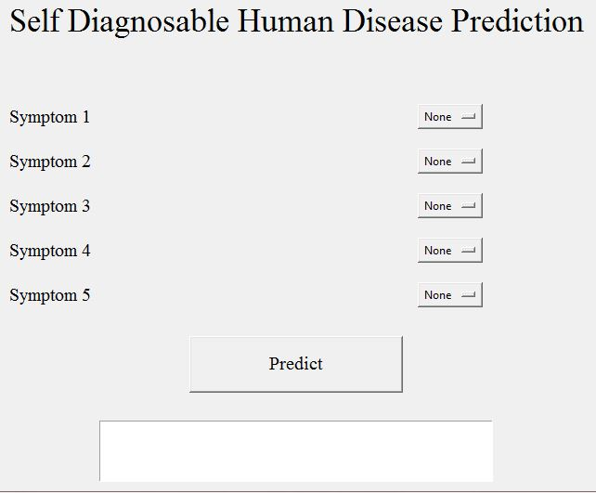
Screenshots:

Slide 29
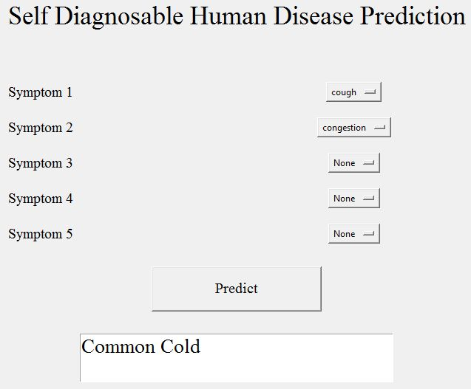
Screenshots:

Slide 30
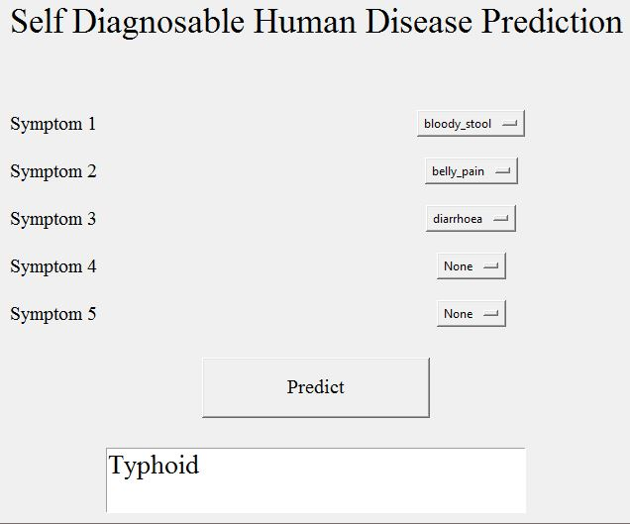
Screenshots:

Slide 31
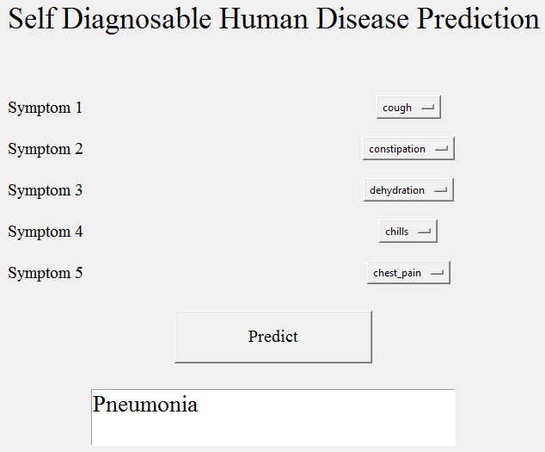
Screenshots:

Slide 32
CONCLUSION
This interactive system will predict the disease of a human being by considering the entered symptoms and these symptoms will be given to the Naive Bayes algorithm which then predicts a disease. And this will make the whole self diagnosable system very easy and effective for common user who do not want to go to a hospital or clinic for health check-ups.

Slide 33
FUTURE ENHANCEMENTS
As now-a-days we can clearly witness the increase in use of computers and technology to consider a huge amount of data, computers are being used to perform various complex tasks with commendable accuracy rates. Machine learning (ML) is a collection of multiple techniques and algorithms which permit computers to execute such complex tasks in a simplified manner. It is also used in both academics which is for students or learners and also in industry to make accurate predictions and use these diverse sources of dataset and information. Till this date we can say we got developed in the fields of Big Data, Machine learning, and Data Sciences etc and have been a part of one of those big industries which were able to collect such data and the staff to transform their goods and services in a desired manner. The learning methods developed for these industries and researches offer excellent potential to further improve in medical research and clinical care for the patients in the best possible way.

Slide 34
BIBLIOGRAPHY
D. W. Bates, S . Saria, L. Ohno-Machado, A. Shah, and G. Escobar, “Big data in health care: using analytics to identify and manage high-risk and high-cost patients,” Health Affairs.
K.R.Lakshmi, Y.Nagesh and M.VeeraKrishna, ”Performance comparison of three data mining techniques for predicting kidney disease survivability”, International Journal of Advances in Engineering Technology.
Mr. Chala Beyene, Prof. Pooja Kamat, “Survey on Prediction and Analysis the Occurrence of Heart Disease Using Data Mining Techniques”, International Journal of Pure and Applied Mathematics.
Boshra Brahmi, Mirsaeid Hosseini Shirvani, “Prediction and Diagnosis of Heart Disease by Data Mining Techniques”, Journals of Multidisciplinary Engineering Science and Technology.

Slide 35
Thank You

